Slide 1
HSPC 2019 Solution Sketches

Slide 2
Problem | Title
P1 | Counting with Dash
P2 | Counting with Jack-Jack
P3 | Spiraling out of -- or into! -- Control
P4 | ScreenSlaver Detection
P5 | Supervillain Index
P6 | Cross-eyed Hypnosis
P7 | Feeding Jack-Jack
P8 | The Puzzling Hypnosis Goggles

Slide 3
P1 – Counting with Dash (Primality)
The main challenges here were determining whether a number was prime and whether a number was a perfect square. Note that a number could not be both a perfect square and a prime, so there was no need to address such a situation.
For determining primality, ideas that could have come in useful either for the correct answer or for efficiency:
Start with the only even prime as a special case and return true.
Return false for any other even number.
Iterate an index from 3 to the square root of the number and see whether the current index value evenly divided the number, returning false if it did.

Slide 4
P1 – Counting with Dash (Perfect Square)
For determining whether a number was a perfect square, the key question is whether the square root of the number is itself an integer.
It might be tempting to use a test such as:
double sqrt = Math.sqrt(num);
return sqrt == (long)sqrt;
however, due to precision issues with floating point numbers, that might not always return the correct answer.
We could instead use something such as:
long sqrtVal = (long)(Math.sqrt(num));
return (sqrtVal*sqrtVal) == num;
to avoid issues with floating point values.

Slide 5
P2 – Counting with Jack-Jack
A challenge here was structuring the logic to handle numbers that were divisible by both 4 and 5. Such numbers would be divisible by 20.
if (i%20 == 0) answer+="FamFro";
else if (i%4 == 0) answer+="Fam";
else if (i%5 == 0) answer+="Fro";
else answer+=i;
Asking the “4” and “5” questions in advance allows testing if a value is divisible by neither, then testing the other two as non-filtering steps.
boolean divBy4 = (i%4)==0;
boolean divBy5 = (i%5)==0;
if (!divBy4 && !divBy5) answer+=i;
else {
if (divBy4) answer+="Fam";
if (divBy5) answer+="Fro";
}

Slide 6
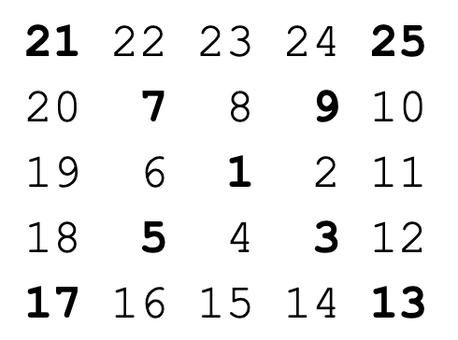
P3 – Spiraling out of -- or into! -- Control
Could consider creating and walking the entire 2D array, or …
Look at the 3 x 3, 5 x 5, …, n x n square alone:
Top left corner is k²
Top right corner is k² – k + 1
Bottom left corner is k² – kn + 2
Bottom right corner is k² – kn + 3
So, sum those and iterate 1 + (k = 3, k =5, …, k = n).
(Closed form polynomial can also be found!)

Slide 7
P4 – ScreenSlaver Detection
A methodical approach to this problem was to read in all of the rectangle bounding box coordinate information, and then iterating through the list of silver rectangles. While iterating through those, for each silver rectangle you iterate through the list of pink rectangles.
For each pink rectangle, testing whether it is contained within the currently chosen silver rectangle is a matter of determining whether all of the following were true of the X,Y coordinates:
The upper-left X of the silver was less than the upper-left X of the pink.
The upper-left Y of the silver was less than the upper-left Y of the pink.
The lower-right X of the silver was greater than the lower-right X of the pink.
The lower-right Y of the silver was greater than the lower-right Y of the pink.

Slide 8
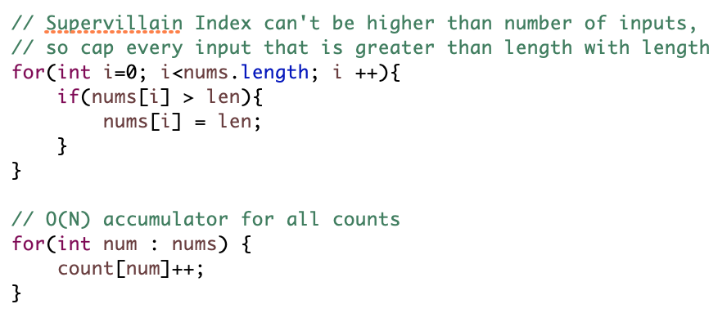
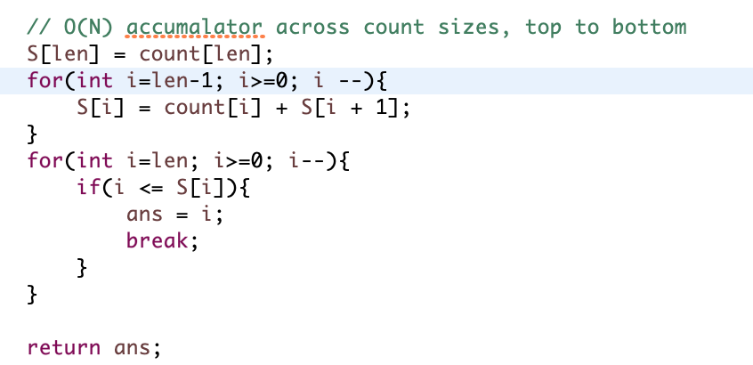
P5 – Supervillain Index
Version of the “H-Index” in Academia
Value of array S_{i} ( S[i] ) is number of Acts having Score at least i.
The first value at index i, from right to left in array S which has i < S_{i} is the Supervillain Index.

Slide 9
P6 – Cross-Eyed Hypnosis
A strongly-reversing pair in array of integers nums is a pair (x, y) such that the following holds:
x < y
nums[x] > 2 * nums[y].
Naïve solution loops and checks – too slow (I think?) for our test cases
Can sort & do a binary search for a speedup

Slide 10
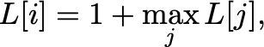

Feeding Jack Jack
P7
Find the longest increasing subsequence
piles=
3
4
4
3
6
Allocate array
L=
1
2
2
2
3
L[i] = Length of longest
sequence ending at i
Use induction formula

Slide 11
P8 – The Puzzling Hypnosis Goggles
Build directed acyclic on words/chars based on ordering
Perform topological sort
Only possible if no directed cycles exist (i.e. you have a DAG)
Can use a sophisticated algorithm (e.g. Kahn’s)
For our test cases, could also just do a DFS
Search until you hit something you’ve seen before (fail/backtrack), otherwise done.

